Slide 1

MECS1023: Advance Data Structure and Algorithm Group 11 Task 2_BST Code
Topic: Furniture Inventory Control Module
Student: Tee Kah hock
Student id: mec245061

Slide 2
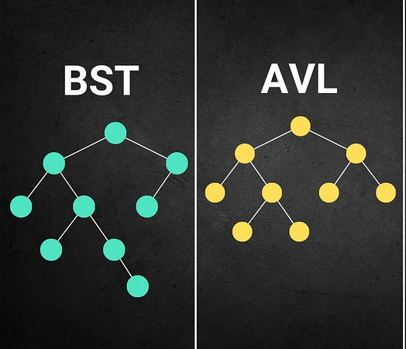
Table Of Content
1 | Function implementation Searching Insertion Deletion
2 | Demonstration of code
3 | Area of Improvement & Future Work

Slide 3
Code structure
The application involves of 4 main sector:
ABSTRACT DATA TYPE (ADT)
The class for FurnitureItem holds all relevant details from csv file.
BST NODE
Create the node structure for the BST, the left and right pointers.
BINARY SEARCH TREE IMPLEMENTATION
Including Insert, Search and Delete function
MAIN APPLICATION
User Interactive interface

Slide 4
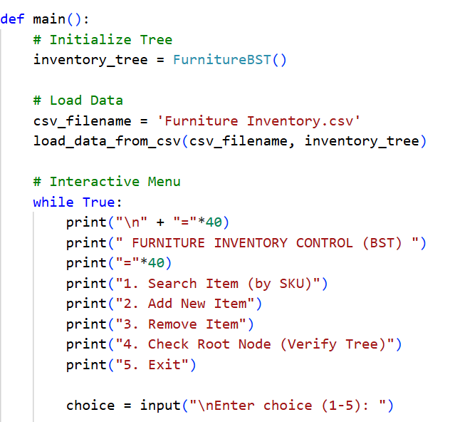
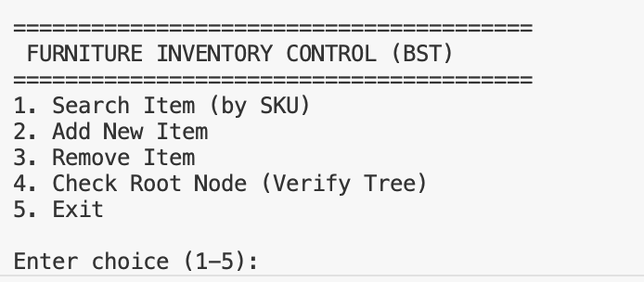
Main Interface

Slide 5
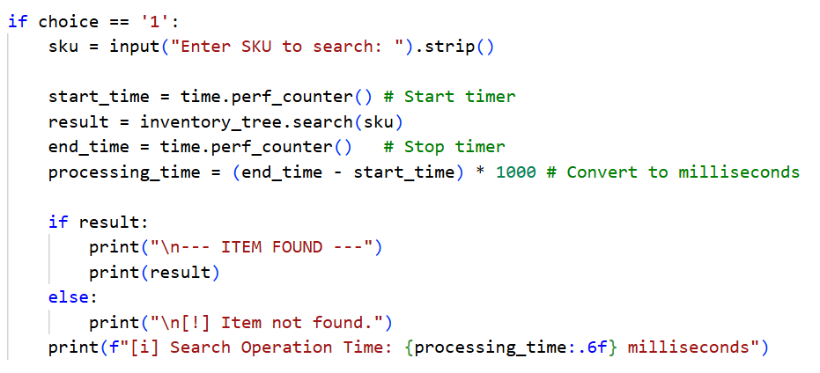
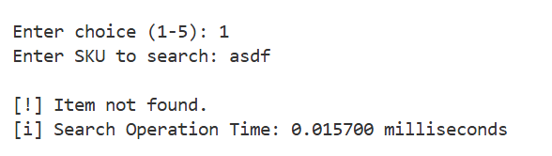
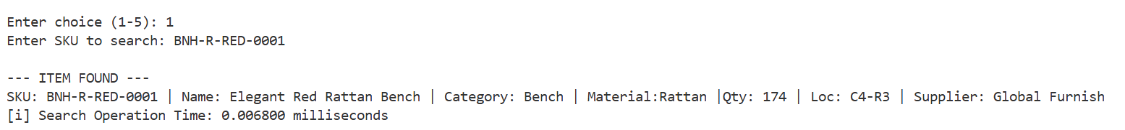
Search Function

Slide 6
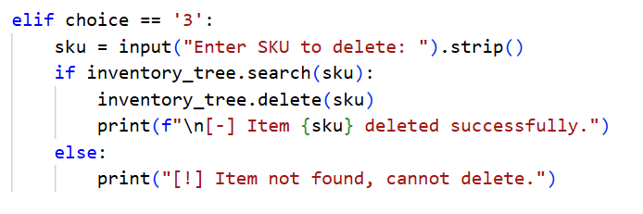
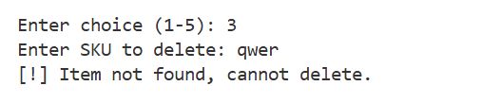
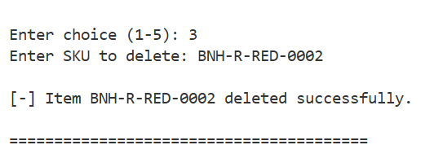
Delete Function

Slide 7
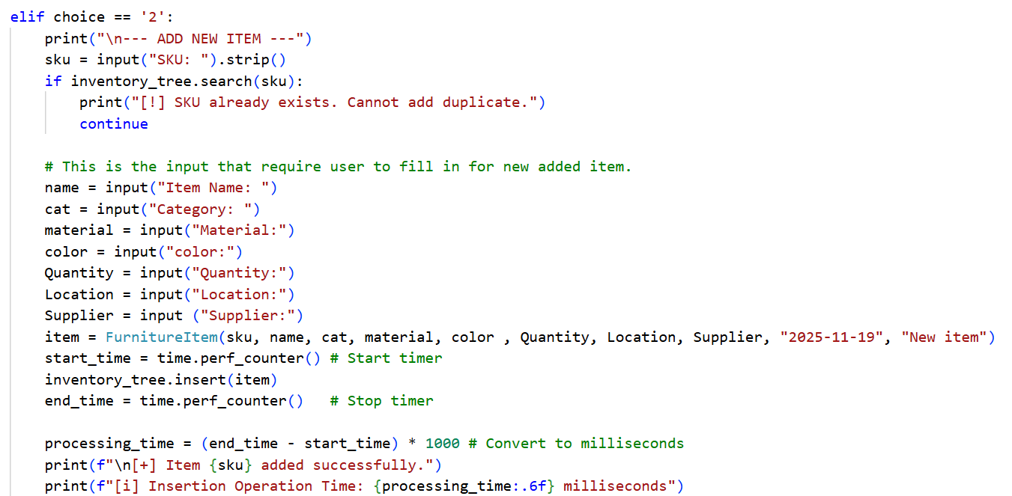
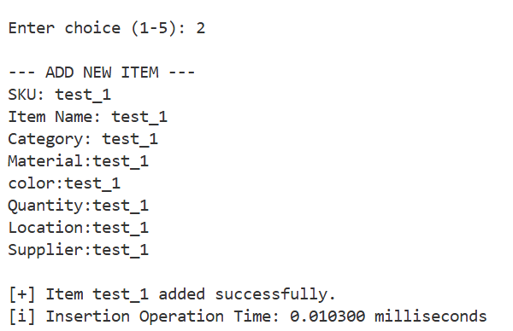
Insert Function

Slide 8


Slide 9



Area of Improvement
The main page can be more interactive with different kind of options for user to choose, such as the algorithm selection (BST, BTREE, AVL, etc..)
Some statistical summary can be added to provide more clearer summary if the user want to pickup the overall information in short period of time.

Slide 10
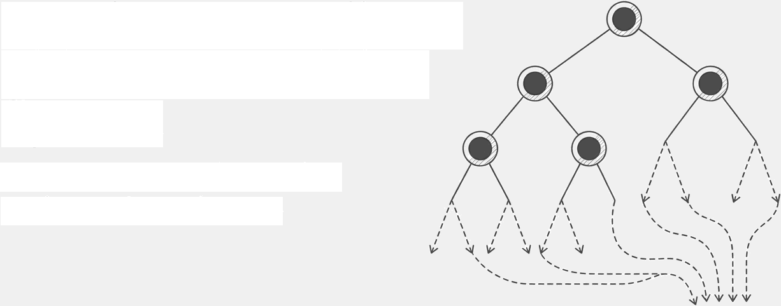

Furniture Supplier & Shipment Tracking System
Solution 1: Implementation Using Binary Search Tree
Prepared By: Tan Zin You
MEC245007

Slide 11

Data Generation
Data Generation & Pre-processing
To ensure the solution is robust, a custom Python script (’dataset_generator.py’) was developed to create a
large-scale, persistent dataset.
Persistence: All generated data was exported to CSV files, simulating retrieval from a static, real-world database.

Slide 12


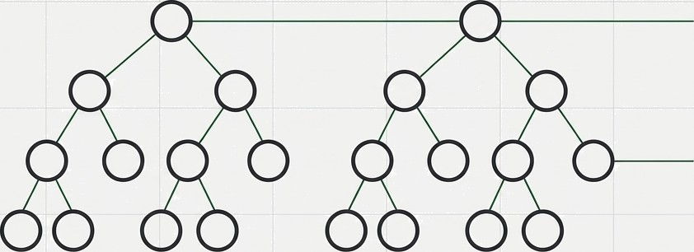
BST Implementation: Solution 1 Architecture
CSV
Data Source
Supplier Management (Tree 1)
Shipment Tracking (Tree 2)
Node Structure (”BST node'): Each node holds a Key (ID), Data (Object), and pointers to Left/Right children.
Sorting Logic: Keys are sorted lexicographically (e.g.,SPL-00001 < SPL-00002).
Traversal: in_order_traversal() used to display sorted data tables.

Slide 13

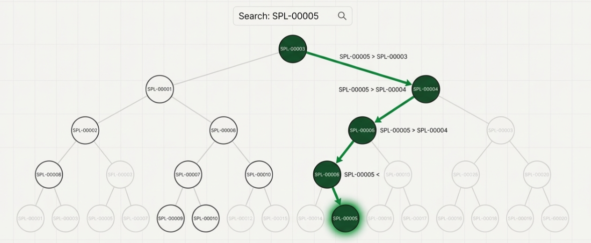
Implemented Functions
Search Operation:
Traverses a single path from the root to find a specific node.
Insert Operation
A recursive function places new nodes within the tree.
1.If new_key < current_node.key”, traverse to the left” child.
2.If new_key > current_node. key”, traverse to the right” child.
3.Repeat until a null position is found and insert the new node.
The operation has a time complexity of ‘0(h)', where 'h‘is the height of the tree. This is highly efficient for balanced trees.

Slide 14
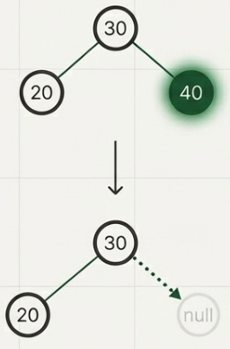
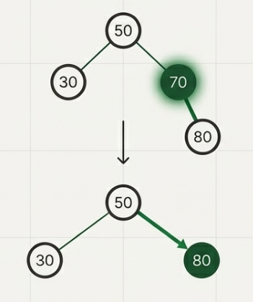
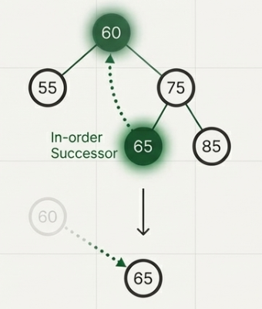
The Deletion Operation: Handling All Cases
Case 1: The Node is a Leaf Case 2: The Node has One Child
Case 3: The Node has Two Children
Logic:
The node has no children.
Logic:
The node has either a left or a right child, but not both.
Logic:
The node has both left and right subtrees.
Action:
Remove the node directly by setting
its parent's child pointer to null.
Action:
Find the In-order Successor: the minimum value nOde in the node's right subtree.
Copy the successor's data into the
target node.
Delete the original successor node (which is now a simpler case).
Action:
Bypass the node by linking its parent directly to its single child.

Slide 15
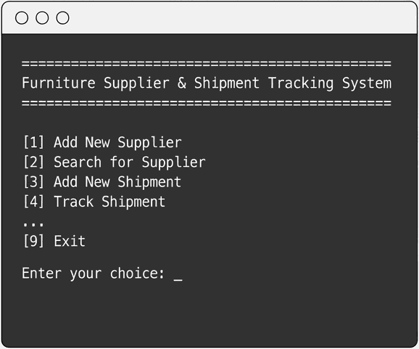
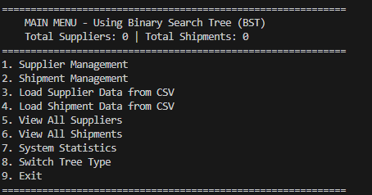





Live Demonstration
Key Scenarios Demonstrated
System Initialisation: Loading the 50,000 shipment and 30,000 supplier records from their respective CSV files into the dual-tree structure.
Record Creation: Adding a new Supplier (”Insert' operation).
Data Retrieval: Searching for specific records by ID ( Search” operation).
Data Removal: Deleting an existing record (’Delete operation).
Display Shipments: Tracking shipments with a specific status.

Slide 16
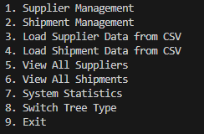
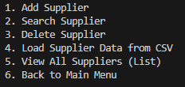
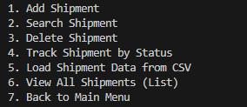
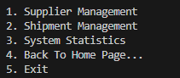
Future Improvements
Planned Improvement 1: Menu Restructuring
Current Menu
Planned Menu
Supplier Operation
Shipment Operation
System Operation

Slide 17
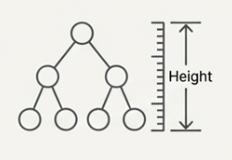
Future Improvements
Planned Improvement 2: Adding Tree Analysis Function
Tree Analysis Functionality
Implement a function to calculate the exact depth and height of each tree.
Strategic Importance
This metric is essential for evaluating the balance of the BST and will provide a critical data point for comparison against a self-balancing B-tree (Solution 2)

Slide 18

Task 2: BST Solution Implementation (Customer Order and Delivery Management Module)
Subject: MECS 1023 Advanced Data Structure & Algorithms Presented By: Lee Qi Hui – MEC255018

Slide 19
Components & BST Property
Python File | Component | Python Class Name | Functionality
order_bst.py | Model Class | OrderNode | Determine key property of the data record by object-oriented
 | Binary Search Tree | OrderBST | Logic engine to achieve Binary Search Tree. Manages all the root pointer and operation within the tree.
main.py | Python Main Class | demonstrate_bst_operations() | Define a procedure to demonstrate all the operations for BST includes Insert, Sorting, Search, Update, Delete

Slide 20
Operation 1: Insert
Feature | Description | Explanation
Method | Public: add_order() Private Helper: _insert_binary_tree() | The insert function is entirely recursive by starting the process from the root until the desire empty pointer is found.
Performance Boundaries | Best Case: O(1) - Constant | The node is inserted instantly when root is None and new node becomes root or the left or right of the root is the target node
 | Worst Case: O(n) - Linear | When the whole tree is unbalanced and the system must travel to every node to find the target node
Time Complexity | Average Case: O(log n) – Logarithmic | The whole tree is well balanced, and the recursive method halves each root after every comparison. Time grows slowly based on the number of orders.

Slide 21
Operation 2: Sorting (Display)
Feature | Description | Explanation
Method | Public: display_all_sorted() Private Helper: _in_order_traversal() | BST can be sorted just following Left < Node < Right rule, keep printing all the value from leftmost root to rightmost root.
Time Complexity | O(n) – Linear | Consistent complexity across all scenarios as it will always require to visit all the branches.

Slide 22
Operation 3: Search
Feature | Description | Explanation
Method | Public: find_order() Private Helper: _find_binary_tree() | The search function is entirely recursive by starting the process from the root and doing comparison, if smaller going left or greater going right until the record is found.
Performance Boundaries | Best Case: O(1) - Constant | The tree is not having any record, and the root is None or the first root is the target node.
 | Worst Case: O(n) - Linear | The target node is placed at the deepest node in the tree, and the tree is only having single branch for all the root.
Time Complexity | Average Case: O(log n) – Logarithmic | The whole tree is well balanced, and the recursive method halves each root after every comparison. Time grows slowly based on the number of orders.

Slide 23
Operation 4: Update
Feature | Description | Explanation
Method | Public: update_order_status() Helper: find_order() | The update function is getting help from the search operation in the system, but only having additional step to update the target node
Performance Boundaries | Best Case: O(1) - Constant | The tree is not having any record, and the root is None or the first root is the target node to update.
 | Worst Case: O(n) - Linear | The target node to update is placed at the deepest node in the tree, and the tree is only having single branch for all the root.
Time Complexity | Average Case: O(log n) – Logarithmic | The whole tree is well balanced, and the recursive method halves each root after every comparison. Time grows slowly based on the number of orders.

Slide 24
Operation 5: Delete
Feature | Description | Explanation
Method | Public: delete_order() Helper: find_order() Private Helper: _find_min_node() _delete_binary_tree() | Rearranges pointers based on 3 cases: 1. Leaf: Returns None (Link removed) 2. 1 Child: Returns the child (Link skips target) 3. 2 Children: Swaps data with Successor & deletes successor
Performance Boundaries | Best Case: O(1) - Constant | The tree is not having any record, and the root is None or the first root is the target node to delete.
 | Worst Case: O(n) - Linear | The target node to delete is placed at the deepest node in the tree, and the tree is only having single branch for all the root.
Time Complexity | Average Case: O(log n) – Logarithmic | The whole tree is well balanced, and the recursive method halves each root after every comparison. Time grows slowly based on the number of orders.

Slide 25


